Slide 1
From Callback Hell to Async Heaven – Promises!
A Play in Three Acts: Inferno, Purgatorio, and Paradiso

Slide 2

The Road To Hell Is Paved With Good Intentions
Act I: Inferno

Slide 3
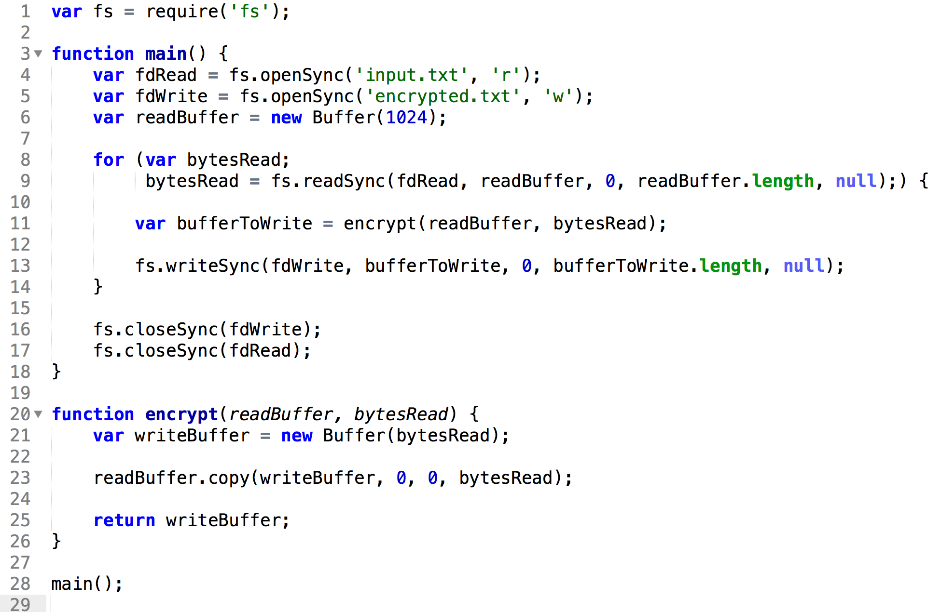
Our Journey Begins

Slide 4
Focusing on the Main Code

Slide 5
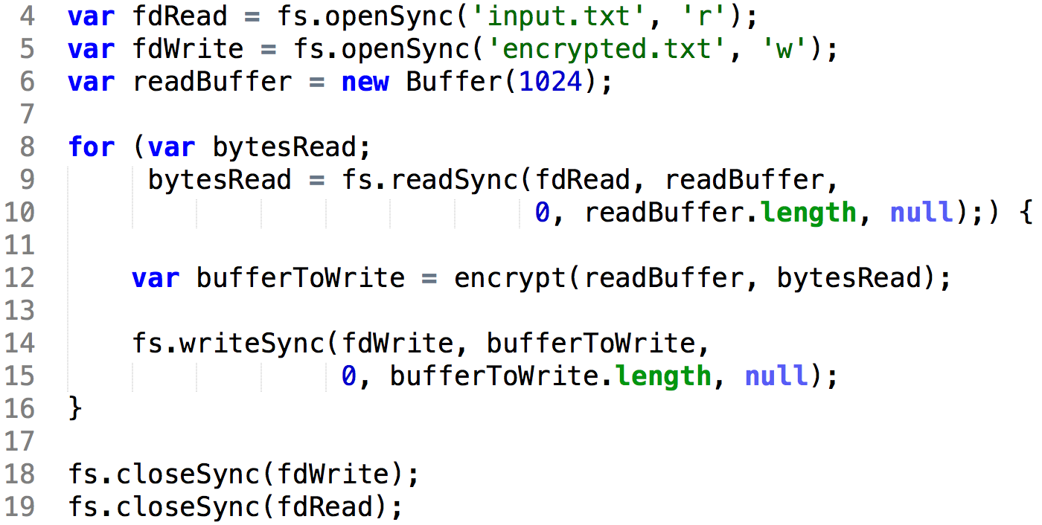


The Good and the Bad
Holds the Thread!
Not Async!
Simple
Readable
Debuggable

Slide 6

So How Do we Release The THREAD?
Callbacks!

Slide 7
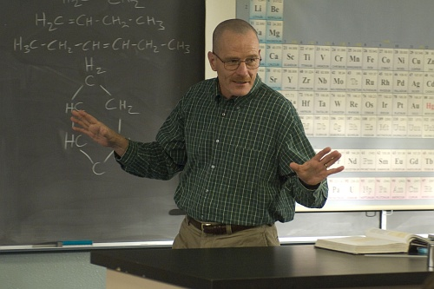
Callbacks
Good Intentions

Slide 8
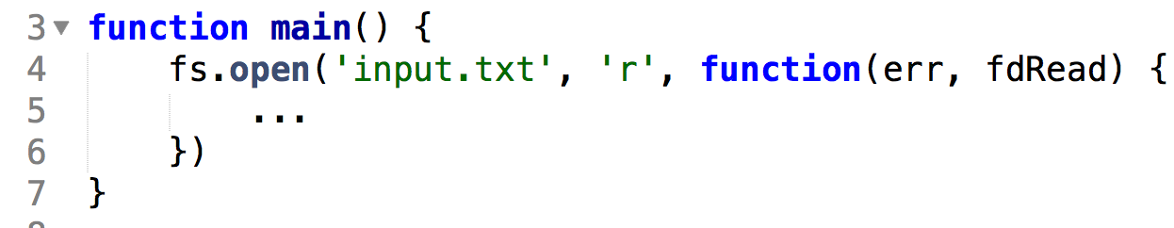
Looks Good…

Slide 9
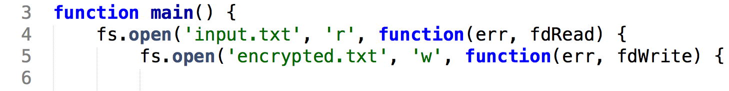
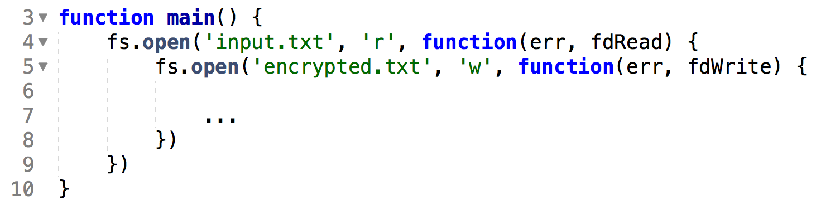

Doesn’t Look to Bad…

Slide 10
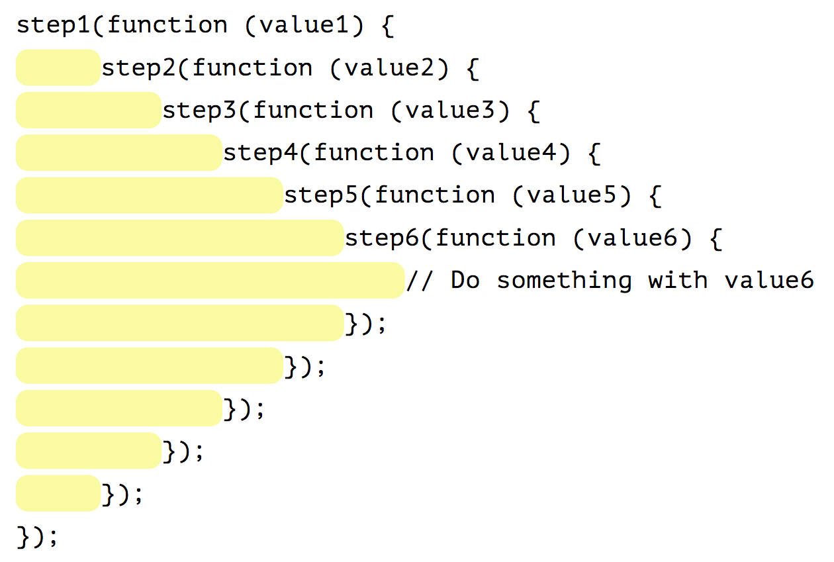
The Pyramid of Doom!
Or As I Call It…

Slide 11

The Pit of Despair!

Slide 12
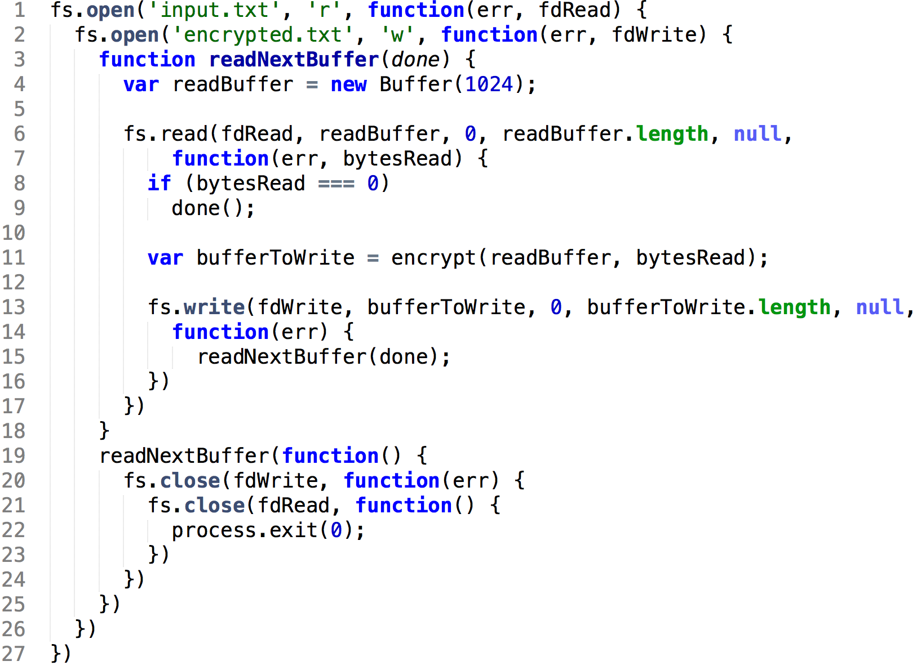
Our Code, In Hell

Slide 13
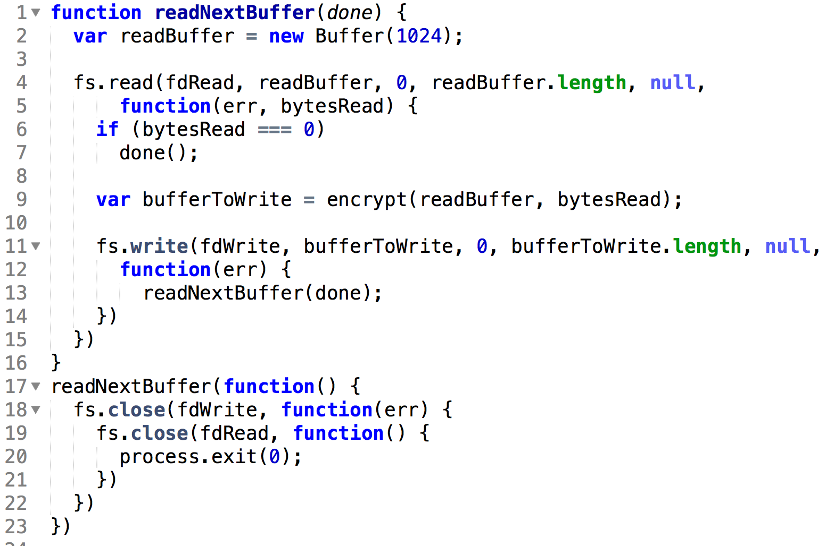
In Callback Hell, There are no Loops!

Slide 14

But I Promise – It Gets Better
Act II: Purgatorio

Slide 15
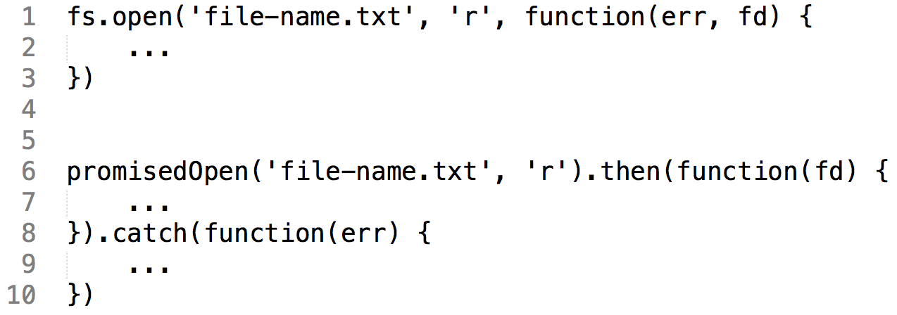
Promises Instead of Callbacks

Slide 16
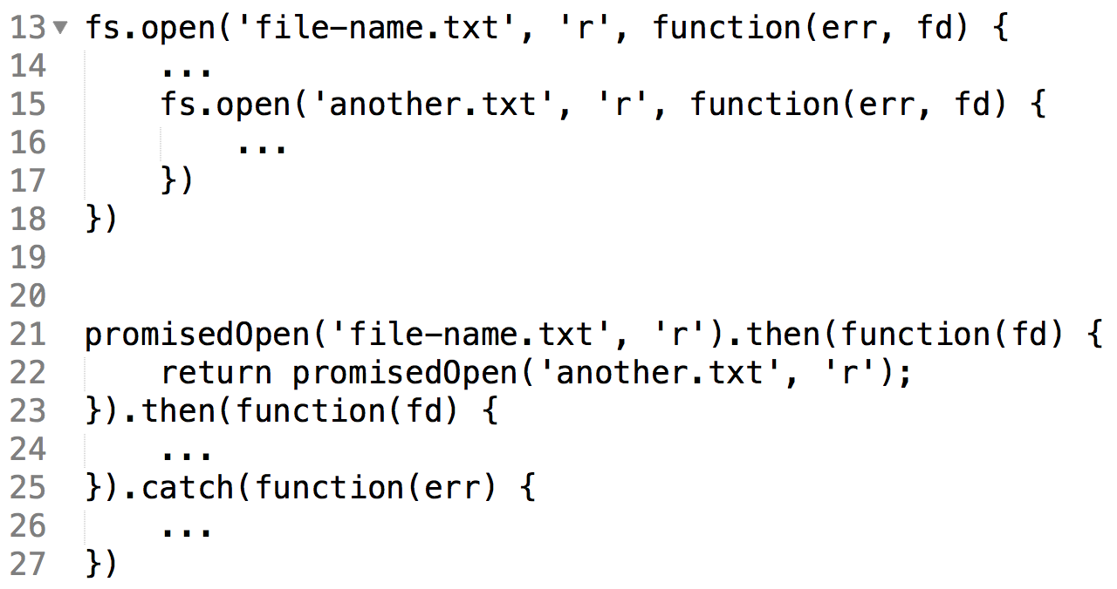
Chaining Promises
The Pit of Despair - Solved!

Slide 17
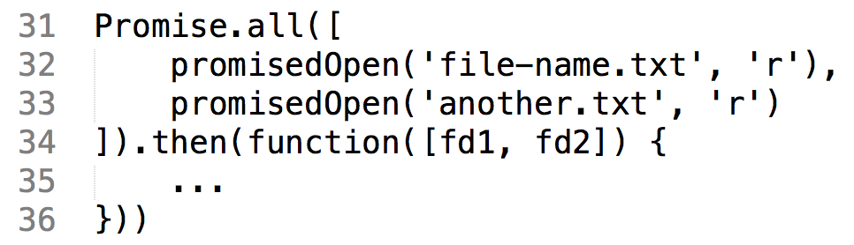
Easy Concurrency
ES6!

Slide 18
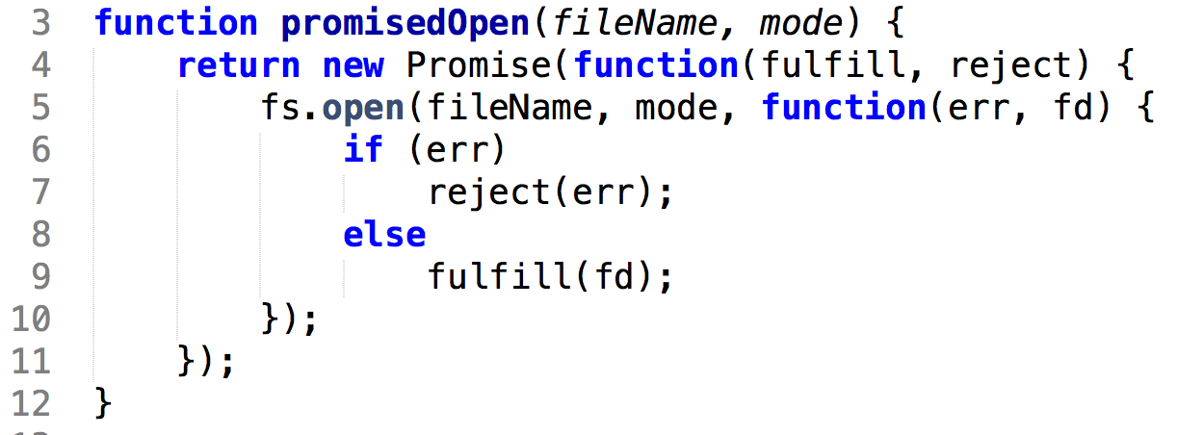
So How Do We Write promisedOpen?

Slide 19

Yes, But How do Promises Work?
I don’t know
And if I try to understand, my head hurts
I just learn to accept it

Slide 20
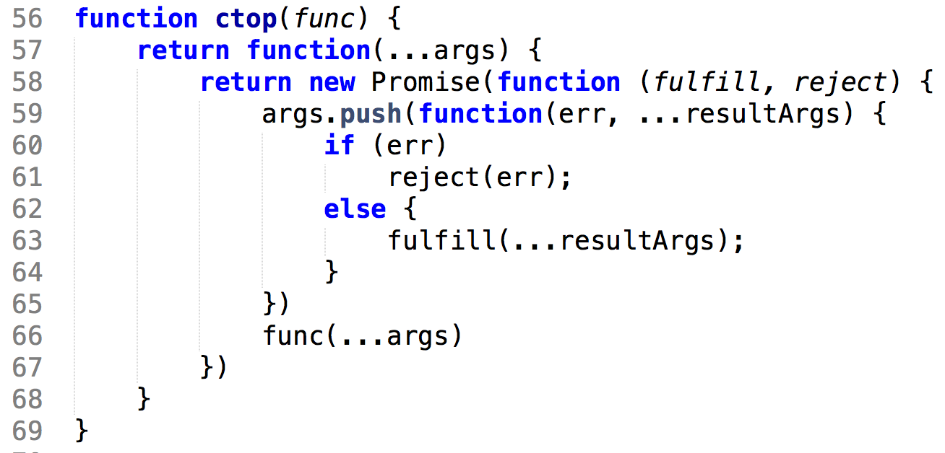
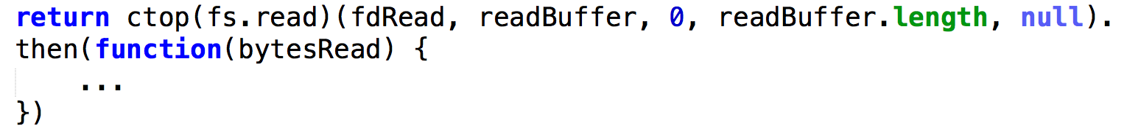
Generalizing promisedOpen Across All Node Functions
ES6!

Slide 21
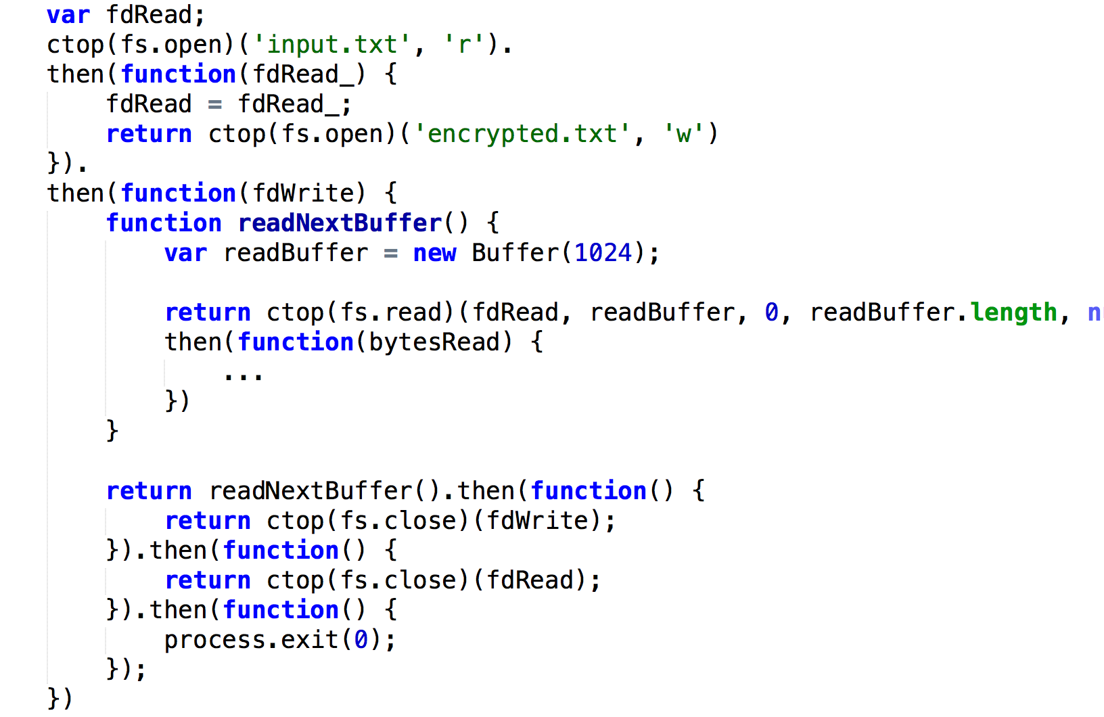
So Where Does This Take Us?
Ugh…
We Were Promised Heaven
But Are Still In Hell!
Still no loop

Slide 22

Promises Must Be Kept – Onward To Async Heaven!
Act III: Paradiso

Slide 23
But Let’s Yield To A Little Detour

Slide 24
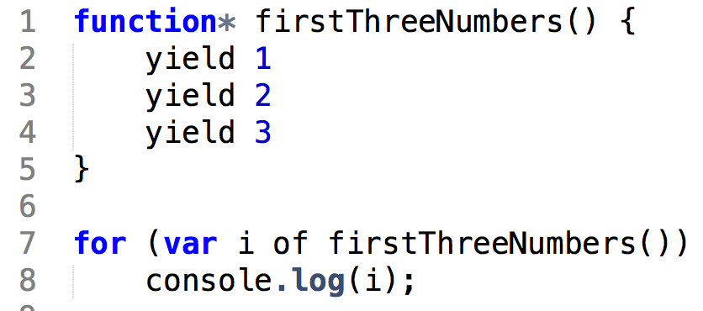
Generator Functions
Only ES6!

Slide 25
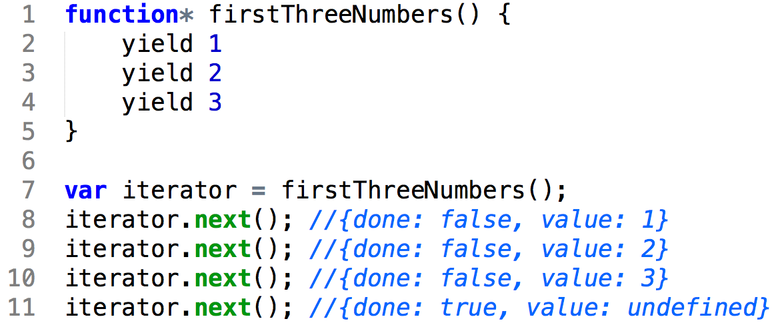
Iterator Protocol

Slide 26
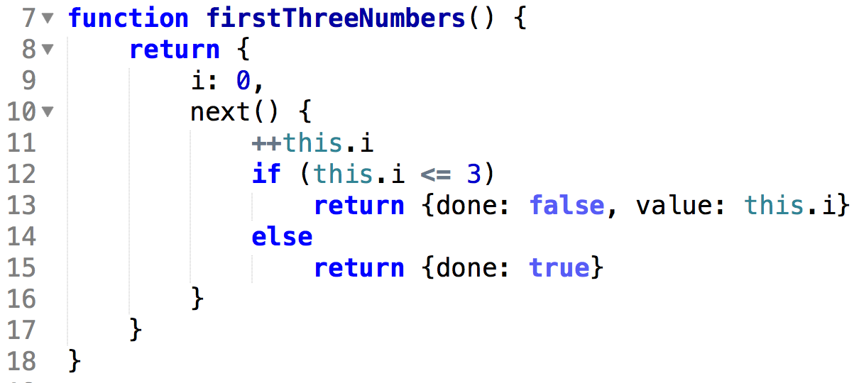
We could have done it like this…
ES6!

Slide 27
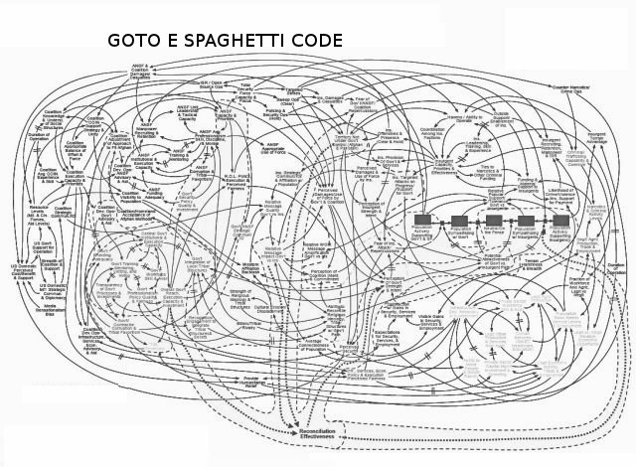
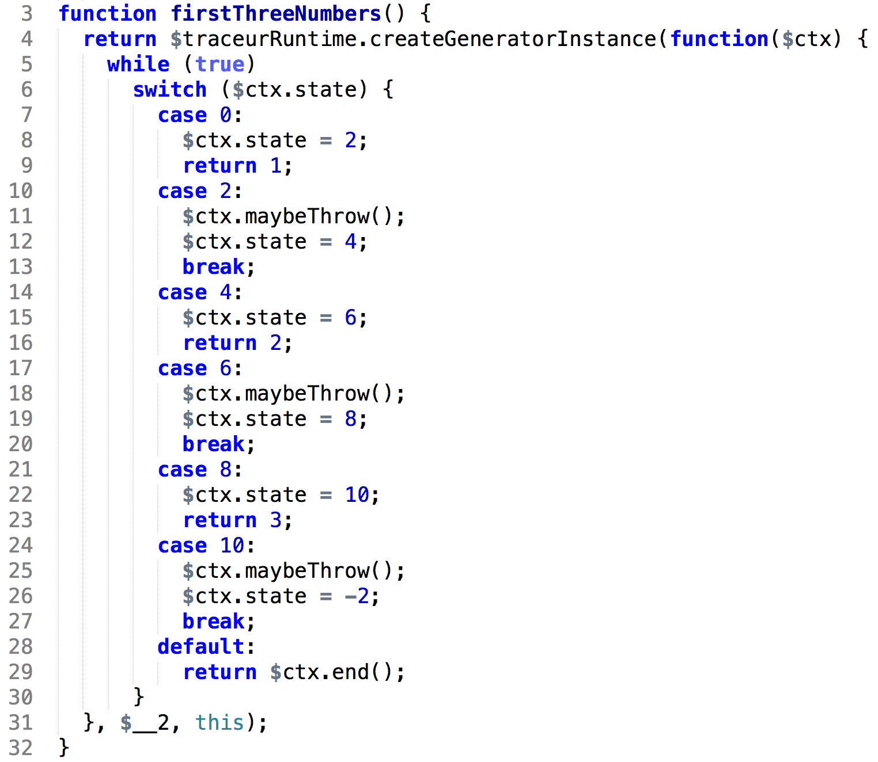
But the ES6 compiler does it like this…
Just Don’t Think About it!

Slide 28
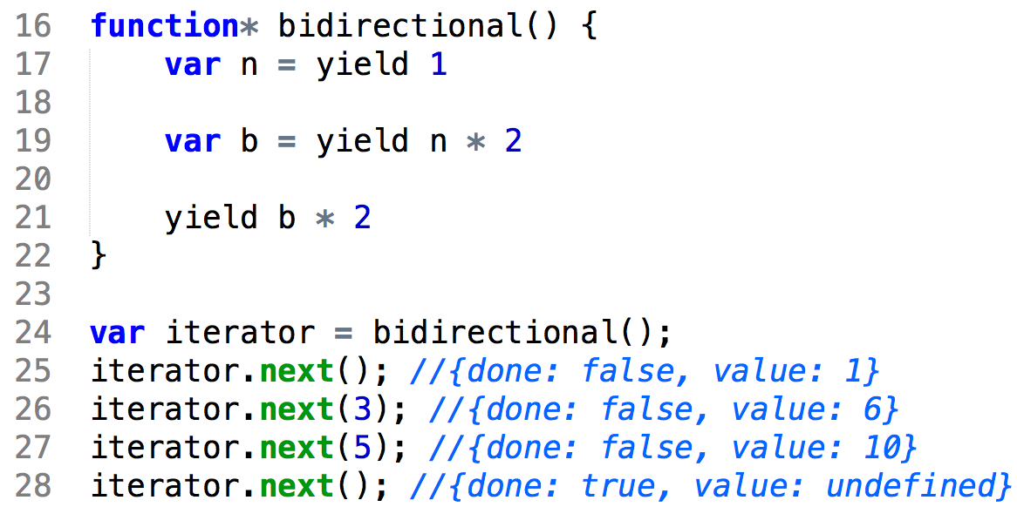
Bi-Directional Protocol
Co-Routines

Slide 29

This Is Where It Becomes Mind-Boggling

Slide 30
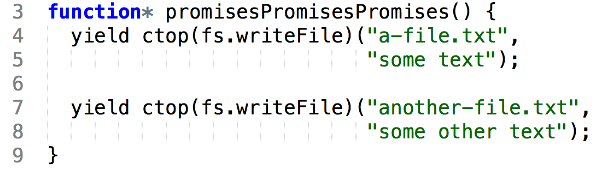
Can We Fulfill The Promise?

Slide 31
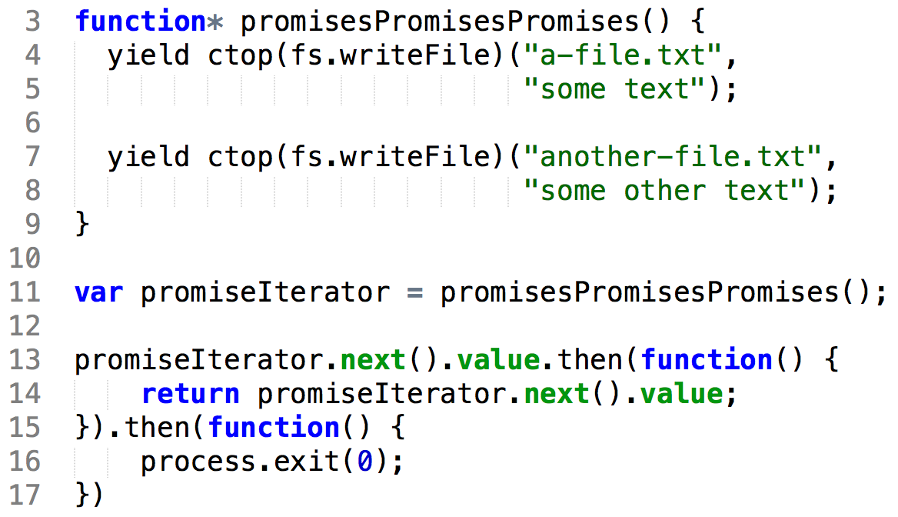
Sure!

Slide 32
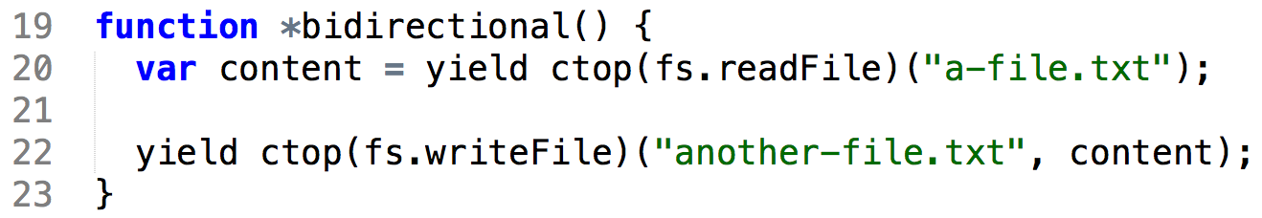
So What About This?

Slide 33
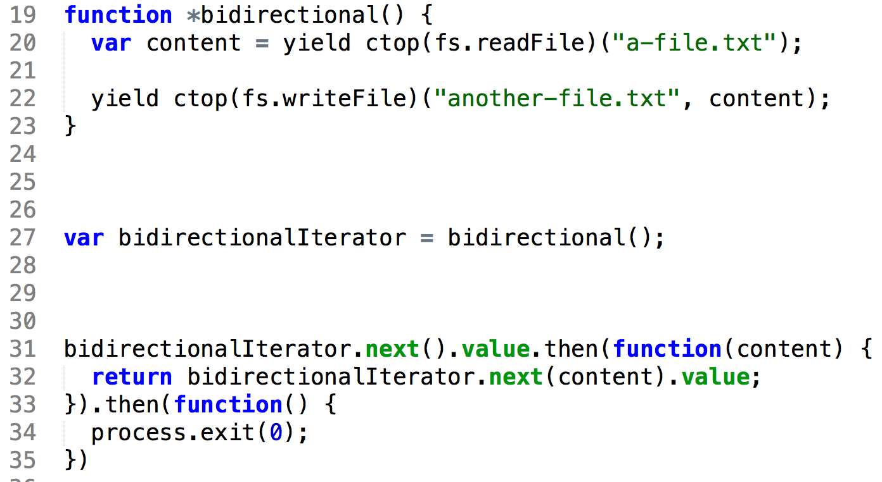
No Problem!

Slide 34
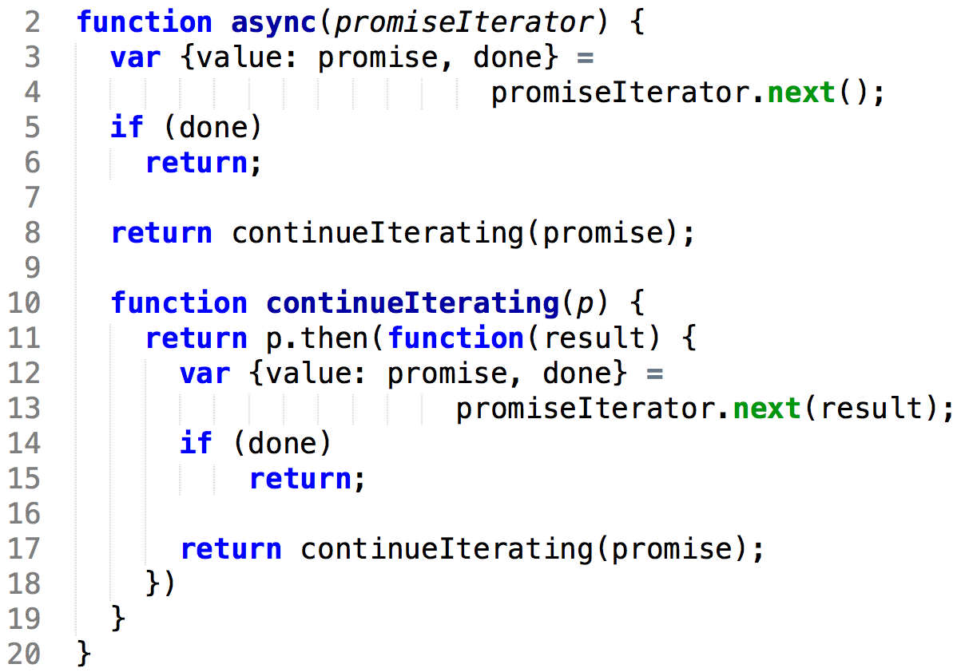
Let’s Generalize

Slide 35
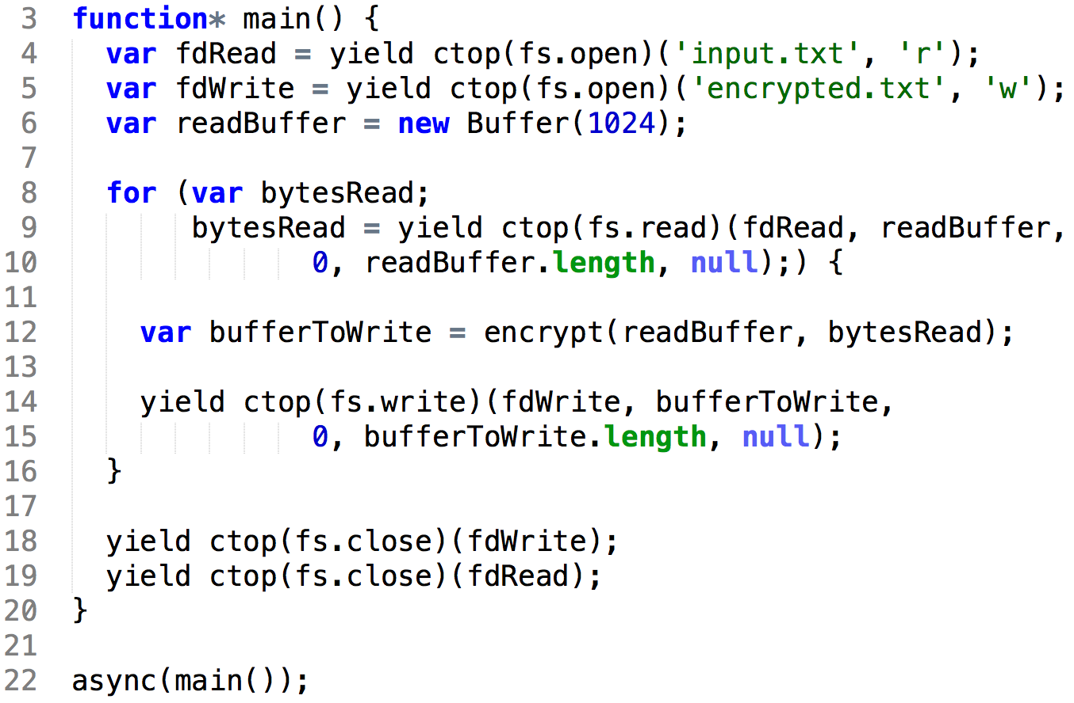
And… Async Heaven!

Slide 36
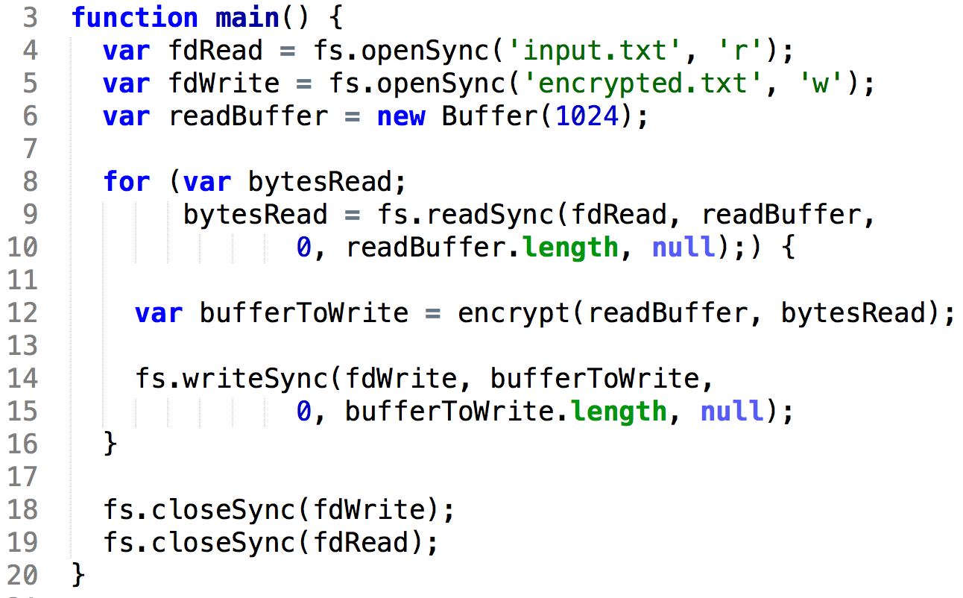
Compare

Slide 37
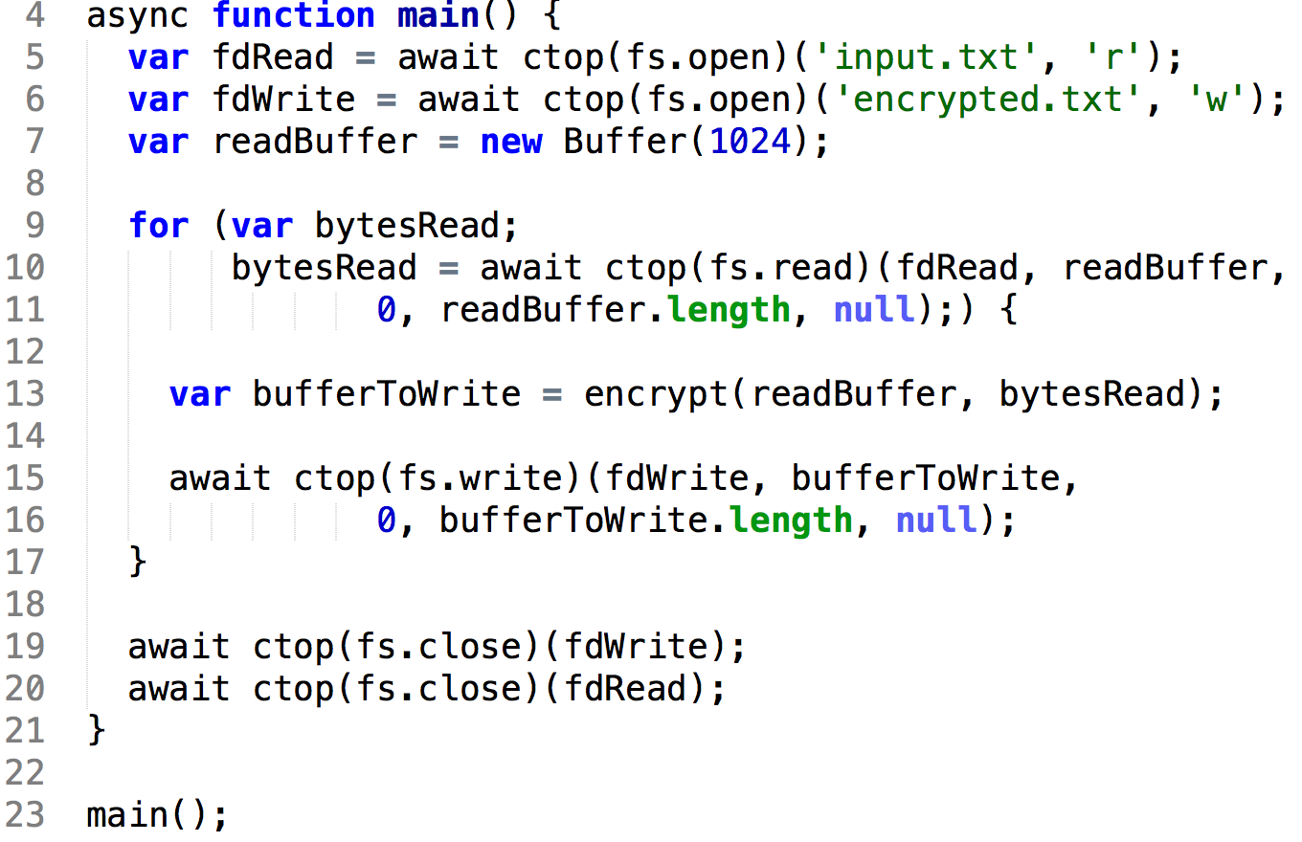
The Future
ES7!

Slide 38
So…
Epilogue

Slide 39
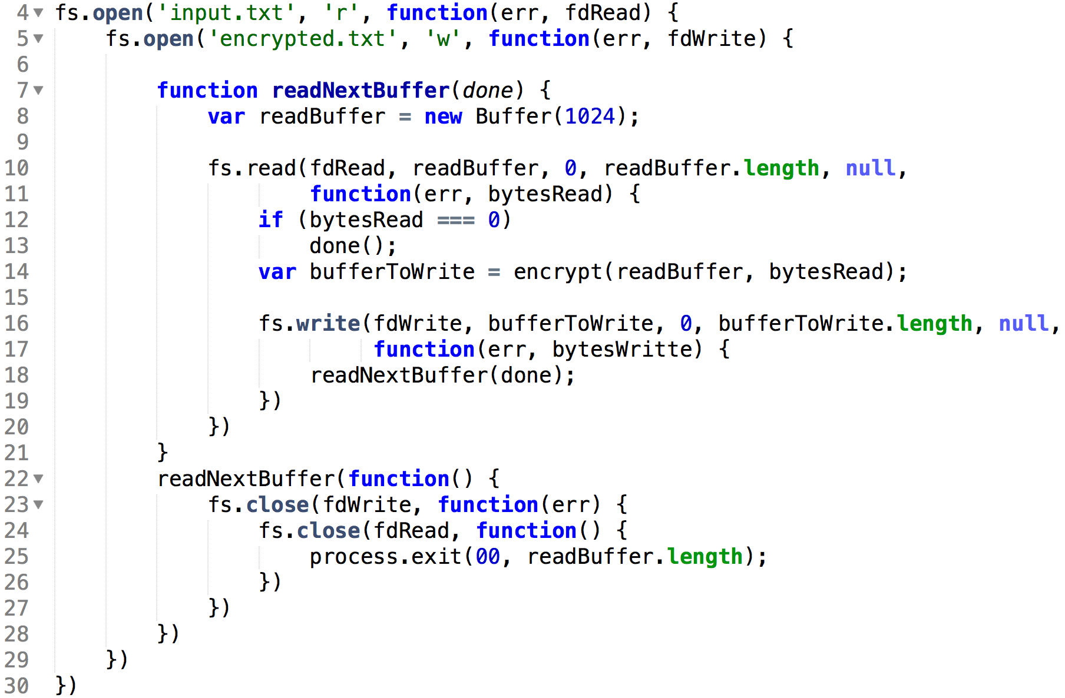

From Callback Hell

Slide 40

To Async Heaven

Slide 41
Our Journey is Complete
Thank You
https://github.com/giltayar/callback-to-async-presentation

